Slide 1
Cover slide
Name
Institution
Course
Instructor
Date
Notes:
The American Civil Liberties Union defines racial profiling as “the ordinary practice by law enforcement officials of targeting individuals for suspicion of crime based on the individual’s race, religion or national origin.” This definition seems to narrow down the meaning of racial profiling to policing. Also, the profiling entails stereotyping of a specific segment of the population by the public. The public can discriminate or negatively consider others as offenders or potential threats to them.
An excellent example is the September 11 terrorism attack on in the USA. The episode fuelled high levels of stereotyping and exclusions on Muslims based on the fact that the perpetrators of the attack were Muslims affiliated to the Al-Qaeda terrorist network. People could cancel flights that had Muslims on board.

Slide 2
Racial Profiling
Targeting individuals for suspicion of crime based on the individual’s race, or national origin.”
stereotyping of a specific segment of the population by the public.
  The public can discriminate or negatively consider others as offenders or potential threats to them.
Notes:
The American Civil Liberties Union defines racial profiling as “the ordinary practice by law enforcement officials of targeting individuals for suspicion of crime based on the individual’s race, religion or national origin.” This definition seems to narrow down the meaning of racial profiling to policing. Also, the profiling entails stereotyping of a specific segment of the population by the public. The public can discriminate or negatively consider others as offenders or potential threats to them.
An excellent example is the September 11 terrorism attack on in the USA. The episode fuelled high levels of stereotyping and exclusions on Muslims based on the fact that the perpetrators of the attack were Muslims affiliated to the Al-Qaeda terrorist network. People could cancel flights that had Muslims on board.

Slide 3
History of racial profiling in US
The practice stems back during the ages of slavery when the image of African Americans was associated with crime and danger.
  The notion became pervasive to justify a continued pattern of racial inequality and exploitation of African Americans
Attempts of relegating African Americans to a lower status in the American community and putting them under constrained control.
  Similar trends could also be traced during the Jim Crow era.
Notes:
Racial profiling has a long history in the soil of the USA. The practice stems back during the ages of slavery when the image of African Americans was associated with crime and danger. The notion became pervasive to justify a continued pattern of racial inequality and exploitation of African Americans, which has persisted into the post-racial Era (Padula, 2018). An excellent example is the Philadelphia court which in 1693 gave the police officers the authority to detain any African American seen loitering aimlessly. Since the 18th century, slave patrols used to stop blacks and confirm if they were lawful. The trend transcended into the 19th century when black codes were introduced in the USA. The principles included rules and laws that were put in place in the South to impose control over former slaves and the freed slaves.
The codes also worked towards relegating African Americans to a lower status in the American community and also to put the African Americans under a constrained control. Similar trends could also be traced during the Jim Crow era, which was characterized by high levels of segregation and discrimination in people of colour.

Slide 4
History of racial profiling cont’
African Americans have been branded as drug peddlers and criminals.
  It is common for people of colour to be stopped on the American roads for checks by the traffic police compared to their white counterparts.
The same trend can be traced across the border in Canada.
  Black Canadians lead in terms of police profiling. When the government came up with the “War on Drugs” initiative in 1982, black Canadians were the primary culprits of the police patrols.
The phenomenon led to a high rate of incarceration that was fuelled by the misconception that young black Canadians were more likely to be involved in drugs or any other dangerous activities.
Notes:
Historically, African Americans have been branded as drug peddlers and criminals. For this reason, they form the largest population in the American prison population dispute the fact that they are among the minorities in the USA. It is common for people of colour to be stopped on the American roads for checks by the traffic police compared to their white counterparts. The same trend can be traced across the border in Canada.Black Canadians lead in terms of police profiling. When the government came up with the “War on Drugs” initiative in 1982, black Canadians were the primary culprits. Police carried out intensive patrols in low-income areas majorly occupied by blacks, especially in Ontario (Guo& Wong, 2018). The phenomenon led to a high rate of incarceration that was fuelled by the misconception that young black Canadians were more likely to be involved in drugs or any other dangerous activities.

Slide 5
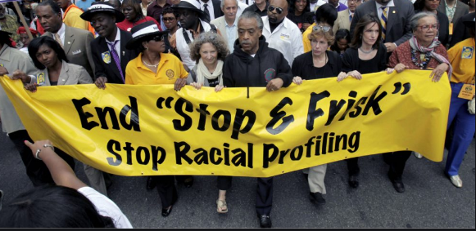
Protests against racial profiling
Demonstrations against racial profiling by the police in Boston 2019. The police were accused of increased unreasonable searches on vehicle driven by the black people.

Slide 6
Theoretical perspective of racial profiling
Proponents of racial profiling rest their argument in the conflict theory .
  Laws and enforcement arms are employed in the society by dominant groups to minimize any potential threats that compromise their interests(Petrocelli, Piquero& Smith, 2016).
The potential risks mostly emanate from the minorities and the low population (Martin, 2018).
Racial profiling can be explained by the functionalism theory.
  Racism is morally justifiable with its end product being a racially unequal society.
  Racial inequality is healthy for it leads to better functioning of the community with the dominant group ruling class and the subjects (Martin, 2018).
Notes:
The proponents of racial profiling rest their argument in the conflict theory which states that laws together with the law enforcement arms are employed in the society by dominant groups to minimize any potential threats that compromise their interests(Petrocelli, Piquero& Smith, 2016). The potential risks mostly emanate from the minorities and the low population (Martin, 2018). Another relevant theory that tries to explain racial profiling is the functionalism theory. The central tenet of the idea is that racism is morally justifiable with its end product being a racially unequal society. Racial inequality is healthy for it leads to better functioning of the community with the dominant group forming the ruling class while the minorities fall under the subjects (Martin, 2018)

Slide 7
Theoretical perspective applications
Conflict theory-If looked at closely, the white ruling class and the minority groups have had continued fractions with the whites trying to dominate and eliminate any potential competition and threats from people of color.
Functionalism- The theory can also be applied to racial profiling whereby a segment of the society can be targeted to ensure the safety and the better functioning of the broader community.
The parliament of Canada passed an Anti-terrorism Act and Bill C-17 and 36 including the Public Safety Act, all of which gave loopholes for profiling while enforcing them. Racial profiling has become part and parcel of fighting terrorism.
Notes:
Conflict theory-If looked at closely, the white ruling class and the minority groups have had continued fractions with the whites trying to dominate and eliminate any potential competition and threats from people of color. Functionalism- The theory can also be applied to racial profiling whereby a segment of the society can be targeted to ensure the safety and the better functioning of the broader community. The theory can also be applied to racial profiling whereby a segment of the society can be targeted to ensure the safety and the better functioning of the broader community. An excellent example is the profiling of Muslims and Arabs by the police force of the USA,Canada and most parts of the world. Since the September 11 attack in the USA, travel restrictions were enforced against Muslims and Arabs in the name of securing the national security. In Canada, special forces, for instance, CSIS and RCMP, were under instructions to minimize the occurrence of such an attack.

Slide 8
Types of racial profiling
Asian racial profiling—Asians have had a fair share of racial profiling as well.
Indian racial profiling —American Indians have had endless complaints about senseless stops and searches by the police officers, including sheriffs(Vito, Grossi& Higgins, 2018).
Worksite racial profiling— It entails the Immigration and Naturalization Service, which majorly target ethnic groups of color on the grounds of undocumented labor allegations.
Notes:
Asian racial profiling—The US Census report reveals that Asians are 4% of the total American population. They are about 10 million in number. Asians have had a fair share of racial profiling as well. Some of the examples include the 2001 incident when 14 Asian Americans were stopped in Washington by the police on jaywalking claims.
Indian racial profiling —The National American Indian Housing Council estimates that there are 2.5 million Indians in the USA. American Indians have had endless complaints about senseless stops and searches by the police officers, including sheriffs(Vito, Grossi& Higgins, 2018). Most of the stops occur on roads that lead to and from reservations (Mogensen, 2019).
Worksite racial profiling—Another common form of profiling entails the Immigration and Naturalization Service,which majorly target ethnic groups of colour on the grounds of undocumented labour allegations.

Slide 9
Program issues
Proponents of racial profiling argue that the practice help in deterring and disrupting criminal activities, for instance, disruption of terrorist networks.
    The nailing of suspects disorients their operations hence leading to a reduction in terrorism activities.
Also, they claim that racial policing helps shape the targeted groups to behave according to the law.
  An excellent example is the acquisition of immigration documents by Latinos to avoid friction with the law

Slide 10
Program issues cont’
On the contrary, racial policing has elicited spirited opposition because of various reasons.
  The practice makes law enforcement to lose its meaning and credibility.
  those who are targeted end up losing trust in the police force hence they may not participate in community policing programs nor volunteer meaningfulinformation to the police due to their poor relationship with the law enforcers(Hayle, Wortley, & Tanner, 2018).
  the practice biased in such a way that even though both white and people of color may be proportionally engaging in drug trafficking, only blacks will be targeted hence leading to the capturing of blacks.
Notes:
Proponents of racial profiling argue that the practice help in deterring and disrupting criminal activities, for instance, disruption of terrorist networks. The nailing of suspects disorients their operations hence leading to a reduction in terrorism activities. Also, they claim that racial policing helps shape the targeted groups to behave according to the law. An excellent example is the acquisition of immigration documents by Latinos to avoid friction with the law. On the contrary, racial policing has elicited spirited opposition because of various reasons. One of them is that the practice makes law enforcementto lose its meaning and credibility. Also, those who are targeted end up losing trust in the police force hence they may not participate in community policing programs nor volunteer meaningfulinformation to the police due to their poor relationship with the law enforcers(Hayle, Wortley, & Tanner, 2018). Another argument against racial policing is that

Slide 11
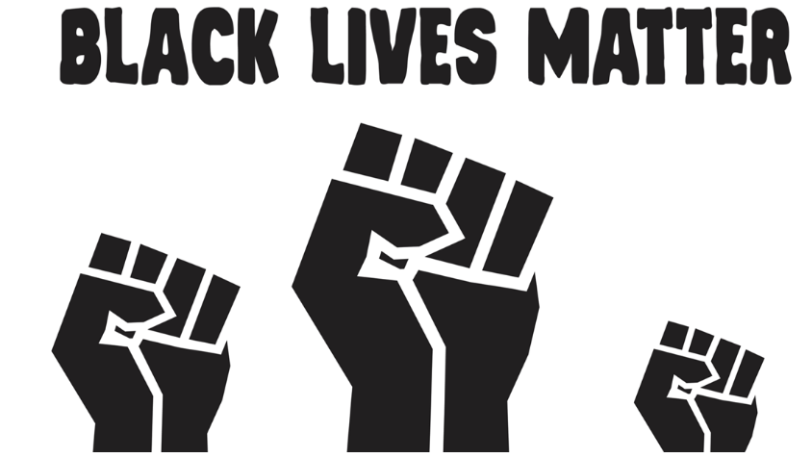
The Black Lives Matter Movement was started to advocate for racial equality and reduce killing of African Americans by the police.

Slide 12
Conclusion
Stereotypic beliefs are a major cause is a major cause of racial profiling.
It has been a major issue since the era of slavery.
The government has failed to establish programs in eradicating racial profiling.
Some perspectives also promote racial profiling especially discrimination of Arabs and Muslims.
Notes:
Racial profiling has been a major issue since the era of slavery which has not been eradicated up to this day. Stereotypic beliefs such as associating the black community with crime or Muslims with crime promote racial profiling. It is easy to say that the government efforts in reducing racial profiling in the United states have not led to any significant changes. Some perspectives of the government such as profiling Muslims to reduce the threat of terror attacks can also promote more discrimination.

Slide 13
References
GuevaRRajR, R. P. (2018). “Latino thReAt in the 808?” Mexican Migration and the. Beyond Ethnicity: New Politics of Race in Hawai ‘i, 152.
Guo, S., & Wong, L. (2018). Immigration, racial and ethnic studies in 150 years of Canada: An introduction. In Immigration, Racial and Ethnic Studies in 150 Years of Canada (pp. 1-17). Brill Sense.
Hayle, S., Wortley, S., & Tanner, J. (2016). Race, street life, and policing: Implications for racial profiling. Canadian Journal of Criminology and Criminal Justice, 58(3), 322-353.
Laurencin, C. T., & Walker, J. M. (2020). Racial profiling is a public health and health disparities issue. Journal of Racial and Ethnic Health Disparities, 1-5.
Martin, J. T. (2018). Police and policing. Annual review of anthropology, 47, 133-148.
Mogensen, A. (2019). Racial profiling and cumulative injustice. Philosophy and Phenomenological Research, 98(2), 452-477.
Padula, G. (2018). Colourblind racial profiling: A history, 1974 to the present. Routledge.
Petrocelli, M., Piquero, A. R., & Smith, M. R. (2003). Conflict theory and racial profiling: An empirical analysis of police traffic stop data. Journal of criminal justice, 31(1), 1-11.
Vito, A. G., Grossi, E. L., & Higgins, G. E. (2018). Analyzing racial profiling from traffic searches. Policing: An International Journal.

